Slide 1

GO TO MARKET STRATEGY
FOR
EBRO E-VAN IN EUROPEAN MARKET

Slide 2
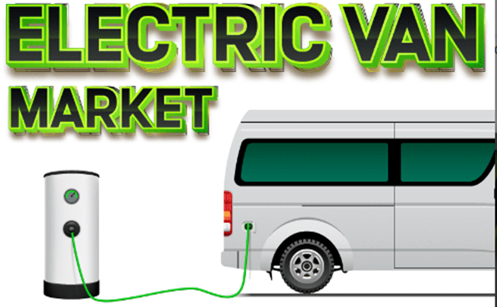
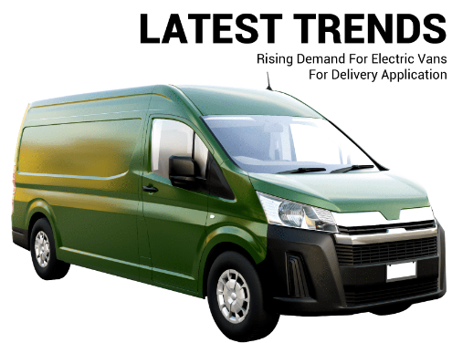





Evolving E-Van Landscape
Following is a bird’s eye view of the E-Van space which is expected to shape the future of mobility solutions
Overview:
The Electric Vehicles market in EU has huge potential for growth with an extremely positive outlook owing to robust automobile industry, mass adoption forecasts & conducive general environment
~$29.65 billion (2023)
13.1%+ CAGR (E) ‘24-’32
~$140.7 billion
(2032)
1000+ Public
charging stations
~1.3% of total vehicle sales (‘20-’21)
Growth drivers & Future prospects
Carbon emission targeting & compliance
Local manufacturing ecosystem development
Govt. promotion scheme
Capacity building & private investment
Collective shift towards clean mobility
Tax exemptions to EV makers

Slide 3
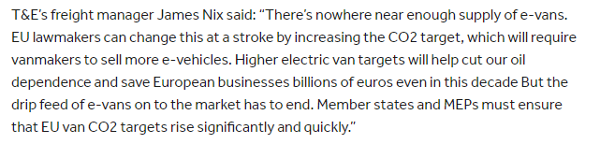
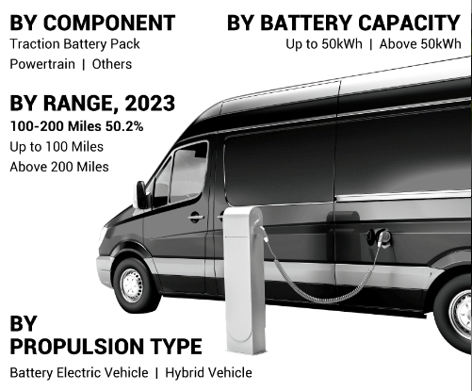
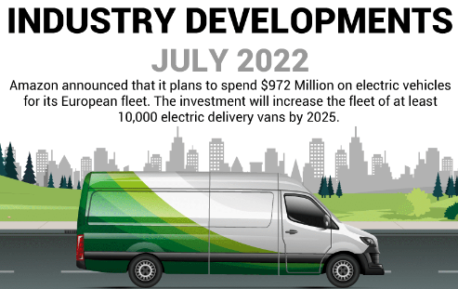
Driving factors
Rising adoption of Electric van owning to better performance & emission free benefits
Voice of experts
Segmentation

Slide 4
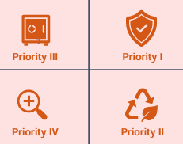




To-be Customer Strategy
Following is a brief overview of customized approach devised for targeted customer cohort:
Customer Acquisition Customer Engagement Customer Retention
EBRO Customer targeting
Creating a best-in-class experience
Personalized driver profiles with custom settings changed with a button
Data driven design with integrated
customer preferences & insights
Fully upgradable, dynamic dashboards & automated driver recognition
B2C strategy
New tech & update beta trial programs for live reaction & suggestions
Timely & personalized recommendations
to improve user driving experience
B2B strategy
Active participation & support in
Government programs & events
Targeted corporate communication to facilitate transparent feedback
Engagement strategies
Large scale, High-end launch events
targeted at gaining huge traction
Participate in Luxury auto exhibitions & organize test drive events
Vehicle life cycle
Proactively participate in the vehicle replacement process of customers to enhance repeat purchases & improve retention rate (91% retention globally)
Service & roadside assistance
Build an expanded network of service centers and EBRO certified technicians for prompt & superior customer service
Value added services & products
Continuously create value for EBRO users including new tech updates, digital functionalities
Customer lifetime
For maximum potential revenue generation throughout the customer lifetime, two-way communication loop for feedback, improvements, suggestions & evolution of needs
High Income
Priority I
Low Income
Priority IV Priority II
Ecologically neutral Ecologically sensitive
Pre Orders & Bookings
Open pre-order option for enthusiasts &
early adopters to get a sense of demand
Customized design & gift bookings to build hype & excitement in new market
Referral & Promotion
Provide EBRO owners with a cash payment for each car sold as referral

Slide 5
PRODUCT SPECIFICATIONS
HIGHLIGHT
BATTERY
2 EUROPALET load capacity.
Flexibility versions, logistics, Taxi, Infotainment system.
Small size for city-urban movements (< 4,6m) - V2V and V2G capabilities.
Battery voltage pack: 230V.
City range: 280 km.
Combined range: 210 km.
Charge 0-80% AC 7kW - 6 hours
Charge 0-80% DC 40kW - 60 minutes
Dimensions: L=4560 x W=1755 x H=1858 mm
Axle base: 2750mm
Estimated weight kg: 1600 kg
Space capacity: 2950 .
DIMENSIONS
L=4560 x W=1755 x H=1858 mm
Axle base: 2750mm
Estimated weight kg: 1600 kg
Space capacity: 2950 L
POWER TRAIN CONFIGURATION
One motor 250 Nm torque- Front axle (FWD) .
Max speed 125 km/h
Load capacity: 750 kg + 2 occupant

Slide 6
TAM: EU market for LCVs is approx. 2.6 million units, electric LCVs to grow at 13.1% CAGR by 2025.
SAM: Focus on urban logistics and last-mile delivery in major cities.
SOM: Target 5-10% of the e-LCV market in EU5 countries over the next 5 years.

Slide 7
EBRO E-Van Value Proposition
- Tangible: 210-280 km range, lower total cost of ownership, leasing/BaaS options.
- Intangible: Sustainability, customer service, EU Green Deal alignment.
- Target Segments: Urban logistics, municipal fleets, last-mile delivery.

Slide 8
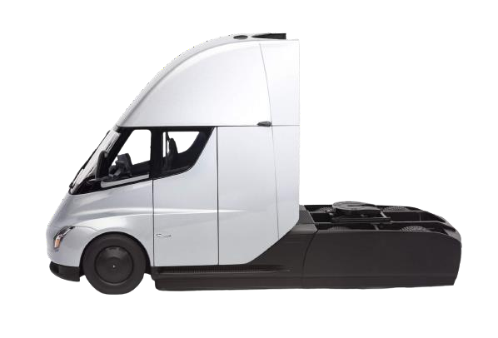
Product Entry Options
Following is the critical evaluation of potential entry models for EBRO
EBRO Urban LCV
The EBRO Urban LCV is an electric light commercial vehicle ideal for city transport and last-mile delivery operations.
With a range of 210-280 km, it targets urban businesses looking for sustainable and cost-effective logistics solutions.
EBRO e-Commercial XL
The EBRO e-Commercial XL is a mid-range electric van designed for B2B logistics and municipal fleet operations.
Offering a 300 km range, it aims to reduce operational costs while providing eco-friendly solutions for commercial fleets.
EBRO Long Haul e-Van
The EBRO Long-Haul e-Van is a high-capacity electric van designed for regional and national delivery routes.
With a 400 km range, it focuses on long-distance logistics while supporting sustainability goals for major corporations.
Details:
Price point ~ 68K
Mile Range ~ 400 miles
Target Segment ~ B2B
Purpose – Utility Vehicle
Payback period ~ 3 years
Details:
Price point ~ 40K
Mile Range ~ 272 miles
Target Segment ~ Last Mile Delivery
Purpose – City Transport
Payback ~ 4 years
Details:
Price point ~ 55K
Mile Range ~ 300 miles
Target Segment ~ B2B
Purpose – Mid Range
Payback period ~ 3 years
Urban LCV ~ GTM Entry Opportunities & Risk
e-XL~ GTM Entry Opportunities & Risk
Long Haul ~ GTM Entry Opportunities & Risk
TOP 3 Opportunities
TOP 3 Opportunities
TOP 3 Opportunities
Letter of Intent from corporates, central & state government
Strong interest from retail chain
Increasing demand for e-fleets due to EU sustainability mandates.
1
Growing demand for urban transport in EU cities.
Corporate partnerships with e-com for large fleet order
Proven track record of the model and the company
1
Partnerships with municipalities for fleet replacement
Best product market fit
Low Lifetime cost enhance B2B appeal
1
2
2
2
3
3
3
BOTTOM 3 Reservations
BOTTOM 3 Reservations
BOTTOM 3 Reservations
1
Limited range could restrict usage to shorter urban routes
Relatively smaller size of target addressable market
High investment and fierce competition from incumebents
1
Dilution of augmented features in the existing line-up
Battery costs and sourcing challenges
Concerns over resale value in a rapidly evolving EV market.
1
Scare battery technology & manufacturing concerns in EU Relatively concentrated TAM (Target Addressable Market) High cost and weaker commercial Evs perception
2
2
2
3
3
3

Slide 9





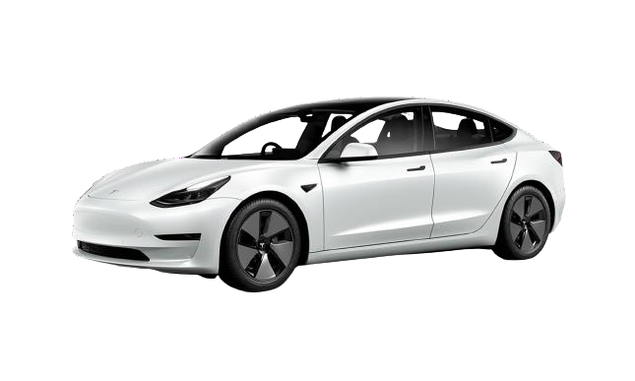
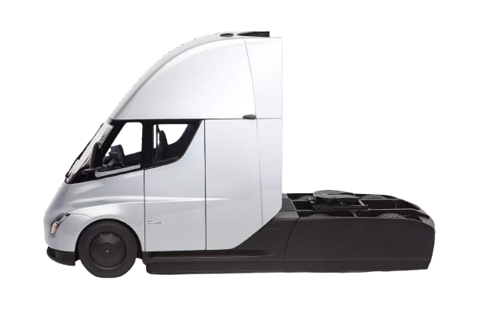
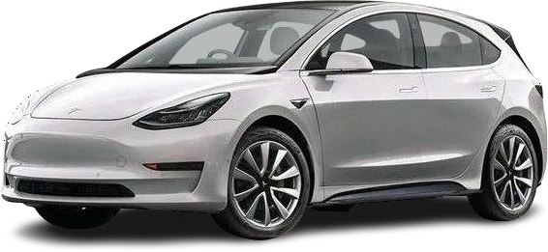
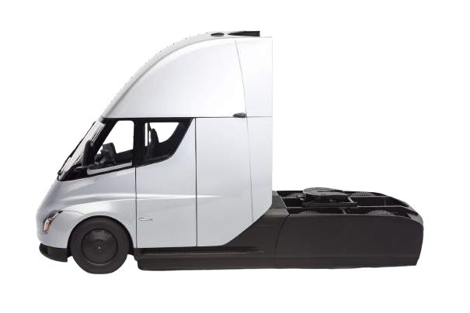
To-be Phase-wise Model Launch
Following is a bird’s eye view of the 3 - year action plan for EBRO to successfully enter and succeed the EU market:
Short term ~ 0-12 months
Medium term ~ 12-24 months Long term ~ 24-36 months
Collaboration with the government, Establishing value chain & Launching Urban LCV
Penetrate the mass market with e-XL, Monetize from capabilities, customers & tech
Sustain customer value; Innovate, Grow & Expand with Long-Haul eVan
Intense marketing of Urban LCV as the aspirational must have
Partner with travel companies and Indian state governments for fleet transformation
Setup physical experience stores of EBRO to establish presence and gain trust
Create a wide charging infrastructure to counter customer anxiety for EVs
for the target customer segment
Brand positioning
Position e-XL as people’s brand for reliable last mile target customers
Aggressive promotion
Expand to commercial vehicle segment, long term engagement projects
Integrate manufacturing and supply chain benefits of EU auto part industry
Aggressive campaigns to establish low ownership cost of EBRO
Sustain
Tech advantage
Invest resources to build process and cost advantage compared to peers
In-situ Operations
Innovate
Retention
Urban LCV Marketing push and launch
Experience stores setup EBRO
Customer traction
Setup EU manufacturing facility to exploit cost and tax advantage
Continuous innovation for emerging needs of the market
Focus on retaining customers with superior after sale service and infra support
Supercharger infrastructure
Actively engage with customer groups to build a long-lasting relationship
Phase I - Quick Wins
Phase II – Expanded offering
Phase III - Full Range
1. Going live with limited units of EBRO BERO Urban LCV targeting the niche, arousing aspirational value for the mass market
1. Going live with limited units of EBRO Urban LCV targeting the niche, arousing aspirational value for the mass market
1. Going live with limited units of EBRO Urban LCV targeting the niche, arousing aspirational value for the mass market
2. Full fledged roll out of the EBRO e-XL across the country, targeting the EU mass market with largest TAM
2. Full fledged roll out of the EBRO e-XL across the globe, targeting the EU mass market with largest TAM
3. Investing in development of public/ commercial vehicles solutions from a long-term perspective basis the traction

Slide 10




Distribution & Retailing
Following is the proposed long - term strategy for product distribution & forward logistics in the EU market
Organic model
Location
Service coverage
Exclusivity
Set up own showrooms, galleries & service centers in addition to online store (Direct Retailing)
Consumer benefit:
Savings in the direct-to-consumer model estimated to be 8.6% of price*
Why not Franchising:
Strategic Store locations:
The EBRO experience:
Superior service delivery:
Existing distributors:
High foot traffic, high
visibility retail venues
Dedicated stores with
exclusive branding
Plan to have more service centers than showrooms
Control & Brand synergies in integrated distribution system, high CapEx investment major concern
Conflict of interest in selling gasoline & electric cars
Self-Cannibalization of
business seen as risky
Interaction with potential customers before they decide which car to buy
Organic footprint for better operations control and real time PoS data
Highly specialized & trained expert professionals for speedy resolution
New distributors:
Product specialists to address customer concerns
High end Galleries for luxury customer segments
Target a service center in <50 miles of every customer
Uncertainty of expertise
related to EV segment
Inability to make a case for
technicalities & features
Focus on store experience
rather than selling more cars
Uniformity of service and delivery across showrooms
Digital services such as store finder for easy access and prompt discovery

Slide 11






Success Factors for EBRO E-Van
Supply chain considerations for EBRO while setting up operations in the EU market
Leveraging Assets Scaling EBRO
Sustaining success
Strong brand recognition
High awareness & deep trust
Customer obsession Compelling, validated value proposition, commercial, branding
Data-driven
For relevant pipeline of offerings, marketing and value points
Ecosystem advantage
Wide reach with customer base and brand
Scalable and flexible technology Own tech stack, 100% automation and decisioning, strong tech capabilities
Risk Management
Mitigate risks as an auto and a tech player
Existing infrastructure
Prior experience, capabilities, and tech superiority
Agile org and governance EBRO as the decision maker, accelerated stagging
Path to profitability
Product sequencing while balancing revenue and costs

Slide 12
CLIMATE/ENVIRONMENT
EUROPEAN POPULATION
 | 2020 | 2024 | 2028 | 2032 | 2036 | 2040
Population in billion | 0.8463 | 0.8439 | 0.8428 | 0.8403 | 0.8366 | 0.8318
Population, 0-14 Years in million | 93.4 | 90.5 | 88.1 | 82.2 | 79.4 | 78.3
Population, 15-24 Years in million | 93.2 | 93.4 | 95.9 | 98.1 | 94.3 | 87.9
Population, 25-34 Years in million | 113.7 | 104.2 | 96.4 | 93.9 | 95.8 | 99.0
Population, 35-44 Years in million | 120.0 | 121.2 | 118.1 | 109.9 | 100.8 | 96.0
Population, 45-54 Years in million | 116.1 | 115.8 | 116.9 | 118.6 | 118.5 | 112.9
Population, 55+ Years in million | 309.9 | 318.9 | 327.4 | 337.5 | 347.8 | 357.8

Slide 13
GROSS DOMESTIC PRODUCT (GDP) OF EUROPEAN MARKET
 | 2020 | 2024 | 2028 | 2032 | 2036 | 2040
GDP (per Capita) in thousand USD (US$) | 25.8 | 32.8 | 38.1 | 43.3 | 48.1 | 52.3
Investment (% of GDP) | 22.5 | 22.3 | 22.3 | 22.3 | 22.3 | 22.3
CONSUMER SPENDING IN EUROPEAN MARKET
 | 2020 | 2024 | 2028 | 2032 | 2036 | 2040
Consumer Spending (per Capita) in thousand USD (US$) | 13.6 | 17.4 | 20.1 | 22.8 | 25.2 | 27.4
Consumer Spending, Purchase of Vehicles (per Capita) in thousand USD (US$) | 0.5 | 0.6 | 0.7 | 0.8 | 0.9 | 0.9

Slide 14
MARKET INSIGHTS
Although, the European Union population is expected to shrink by negligible amount by 2040, the GDP of EU states will considerably increase to 52.3 thousand USD by 2040 from 32.8 thousand USD in 2024. There is also a considerable increase in the consumer spending of per capita purchase of vehicles, which is expected to further allow growth in EV purchase. To corroborate the same, please refere to the EV market size in the previous slide which is expected to grow from a 261 billion dollar at present to 745 billion dollar in 2030
(SOURCE: STATISTA & MORDOR INTELLIGENCE)

Slide 15
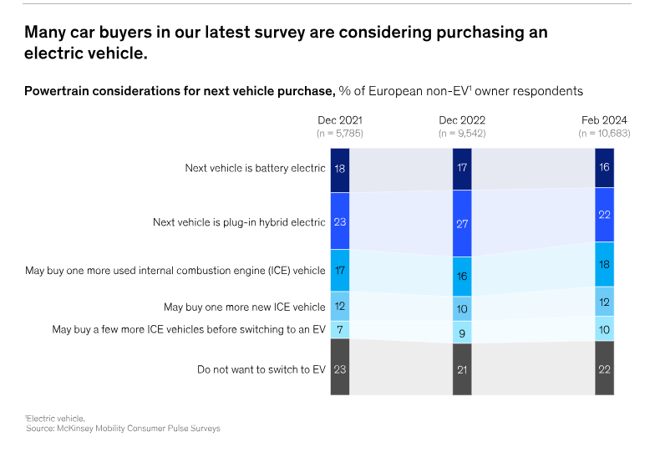
CUSTOMER PROFILE
Electric vehicles (EVs) account for 16 percent of new-car sales in Europe, up from under 1 percent in 2019.
Since the beginning of 2024, more than 875,000 new full battery electric vehicles (BEVs) have been sold across the continent.
A recent survey by Mckinsey & Company has been done in order to understand European consumers’ views on EVs and key market trends.
Individuals from France, Germany, Italy, and Norway were a part of this McKinsey Mobility Consumer Pulse Survey, which closely monitors consumer perceptions about the future of mobility in general in EV Segment.

Slide 16
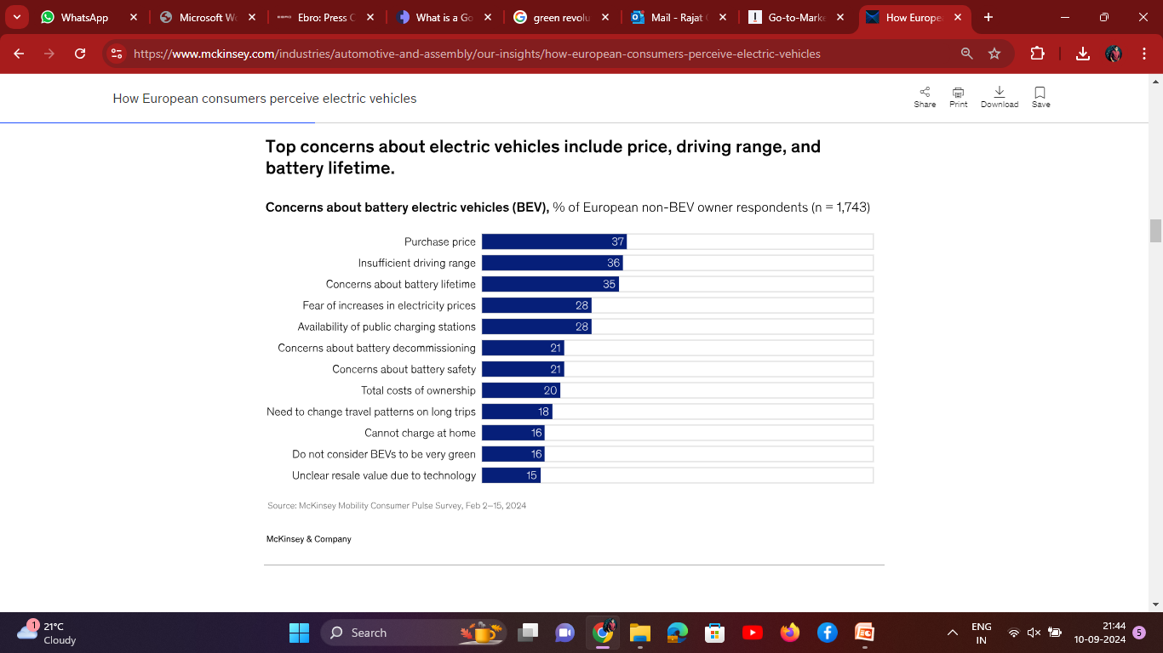
Intent to purchase an EV is slightly higher in the premium-brand segment, as well as among younger and more progressive urban customers, who tend to be environmentally conscious. But interest in EVs is now expanding beyond these groups, and the next wave of buyers may include more older consumers with comparatively lower budgets.

Slide 17
SURVEY FINDINGS
The survey findings suggest that a longer driving range and relatively low purchase could accelerate BEV adoption in Europe, since buyers in this region have high expectations for the real battery driving range. In McKinsey's survey, consumers who would consider an EV but have not yet purchased one, states that the driving range would need to be about 500 kilometers for them to switch from an internal combustion engine (ICE) vehicle to a fully electric BEV (Exhibit 3). Among current BEV owners, expectations for driving range are only slightly lower, at about 470 kilometers.
REFERENCE: https://www.mckinsey.com/industries/automotive-and-assembly/our-insights/how-european-consumers-perceive-electric-vehicles

Slide 18
SPECIFICATION | RENAULT KANGOO E-TECH | CITROEN E-BERLINGO | PEUGEOT E-PARTNER | MAXUS E-DELIVER 3 | CENNTRO LOGISTAR 200 | EBRO - EVAN
VEHICLE TYPE | Electric Compact Van | Electric Compact Van | Electric Compact Van | Electric Small Van | Electric Light Commercial Van | Electric Small Van
BATTERY CAPACITY | 45 kWh | 50 kWh | 50 kWh | 35 kWh or 52.5 kWh | 41 kWh | 40 kWh (MOST LIKELY)
RANGE (WLTP) | Up to 285 km | Up to 275 km | Up to 275 km | 200 km (35 kWh), 342 km (52.5 kWh) | Up to 200 km | Up to 280 km
PAYLOAD CAPACITY | Up to 600 kg | Up to 800 kg | Up to 800 kg | 945 kg | 540 kg | 705 kg (MOST LIKELY)
CARGO VOLUME | 3.9 m³ to 4.9 m³ | 4.4 m³ | 4.4 m³ | 4.8 m³ (short) - 6.3 m³ (long) | 5 m³ | 4.2 m³ (MOST LIKELY)
CHARGING TIME (AC) | 7 hours (7.4 kW) | 7.5 hours (7.4 kW) | 7 hours (7.4 kW) | 6-8 hours (AC 7.2 kW) | 6-8 hours | 0-80% 7 kW – (6 hours)
FAST CHARGING (DC) | 80% in 42 minutes (80 kW DC) | 80% in 30 minutes (100 kW) | 80% in 30 minutes (100 kW) | 45 minutes (80% charge, 50 kW DC) | 30 minutes (20%-80%, 50 kW DC) | 60 minutes (80%, 40 kW DC)
TOP SPEED | 135 km/h | 130 km/h | 130 km/h | 120 km/h | 100 km/h | 125 km/h
POWER OUTPUT | 90 kW (120 hp) | 100 kW (136 hp) | 100 kW (136 hp) | 90 kW (122 hp) | 60 kW (80 hp) | 80 kW (107 hp) (MOST LIKELY)
PRICE RANGE (EUROPE) | Starting from €32,000 | Starting from €30,000 | Starting from €30,000 | Starting from €29,000 | Approx. €25,000 | AVG Price €35,000

Slide 19
COLLABORATORS
CHERRY AUTOMOBILE
The Chinese automaker Chery has entered a joint venture with EBRO-EV Motors. This partnership will focus on producing electric vehicles, including Chery's Omoda models and EBRO-branded cars. The collaboration is significant as it marks Chery’s first manufacturing plant in Europe
:BARCELONA TECHNICAL CENTRE
Ebro and Barcelona Technical Center (BTech) have a close collaboration, particularly in the reindustrialization of the former Nissan plant in Barcelona. Together, they are part of the Decarbonization Hub (D-Hub) initiative, which aims to transform the factory into a center for electric vehicle production
CATALAN GOVERNMENT (ACCIÓ-CATALONIA TRADE & INVESTMENT) & SPANISH GOVERNMENT
The Catalan government & Spanish Government played a crucial role in securing EBRO-CHERY collaboration, facilitating discussions between Chery and EBRO.

Slide 20
GO TO MARKET STRATEGY
FOR
EBRO
E-VAN

Slide 21
TYPE OF GTM FOR EBRO
The global electric vehicle market is growing rapidly, with projections suggesting that it could reach $802.81 billion by 2027. This growth is primarily due to the increasing government support for EVs, rising environmental concerns, and advancements in EV technology. Governments around the world are offering incentives for people to purchase EVs, such as tax credits and rebates, which is driving up demand. In addition, the cost of EVs is decreasing as battery technology improves, making them more affordable for consumers.
we are launching a new product in existing market i.e EBRO E-VAN, therefore, we need to align our Go To Market strategy on similar lines we would be focusing on sales led Go To Market strategy

Slide 22
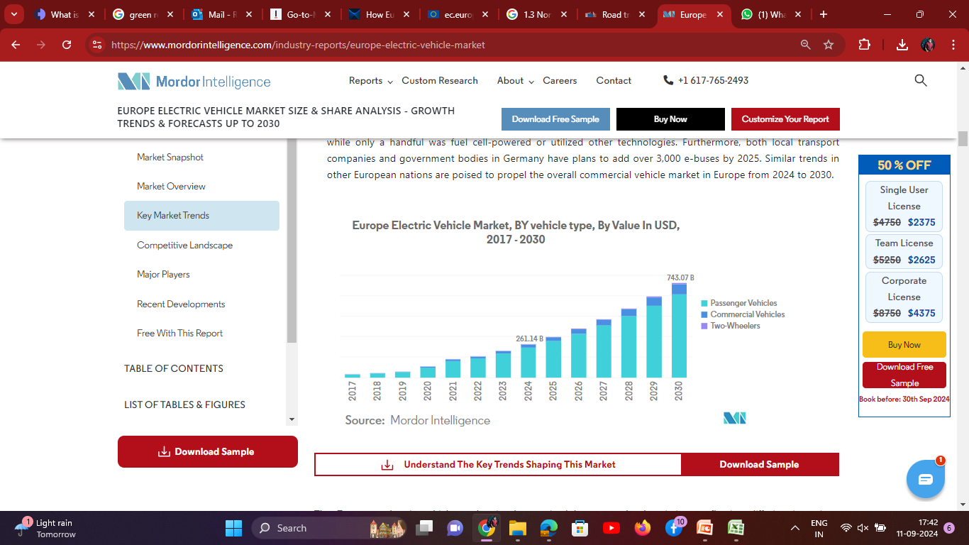
MARKET DEMAND
The demand for commercial vehicles is set to witness a significant uptick in the coming years. Key drivers of this growth include the logistics, supply chain, infrastructure, and construction sectors. Additionally, a rise in public transportation services is bolstering the demand for buses.

Slide 23
However, the sales of commercial vehicles & passenger vehicle experienced a downturn in 2020, largely due to the impact of the pandemic. The market swiftly bounced back in 2021, with Europe's Climate Plan playing a pivotal role. As Europe aims to ban diesel-powered vehicles by 2030, a notable shift is expected to be witnessed among business consumers toward electric commercial vehicles and also in passenger vehicles.
The demand for commercial & passenger vehicles is set to witness a significant uptick in the coming years. Key drivers of this growth include the logistics, supply chain, infrastructure, and construction sectors. Additionally, a rise in public transportation services is bolstering the demand for buses.

Slide 24
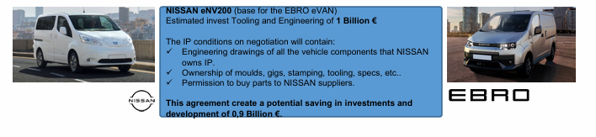
BRAND POSITIONING
EBRO Evan is inspired by Nissan Env200. E-Van is an electric vehicle with proven experience in the market as evident from sale of several units of the NV200 already sold.
Wide range of customers as van and passenger vehicle.
Excellent ratio between footprint and load volume. Narrower vehicle than the competition (1.75m) making it ideal for urban transport
Capacity for two Euro pallets despite its small size. Great accessibility thanks to its two side doors. Excellent ergonomics as a passenger vehicle
European production vehicle.
Extensive customization possibilities
Very competitive in price compared to its European competitor

Slide 25
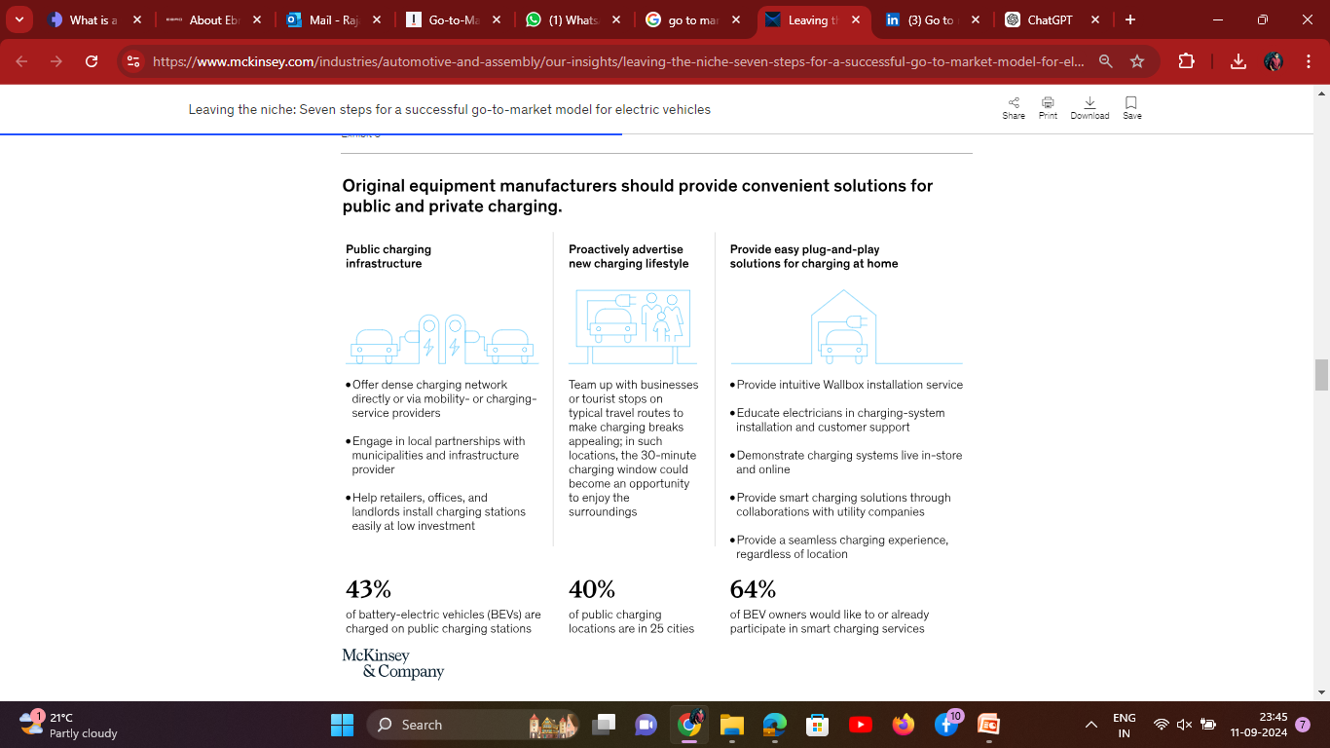
EIGHT STEPS TO POSITION THE E- VAN
STEP 1 : CREATE CHARGING INFRA AS A USP

Slide 26
STEP 2 RE- INVENT BRAND POSITIONING
EBRO can offer attractive new offerings like integrated EV-mobility bundles that include products and services, with a focus on the overall experience. A successful bundle including :-
Proper Charging infra
on-demand features and services
financing options
mobility services
after sales packages and extended warranties.
These elements could create a compelling offer that enhances the customer experience and may resolve concerns that could hinder the adoption of EVs.
EBRO can use innovative and personalized approaches, such as digital campaigns, to reach and educate prospective EV customers. Focusing on areas and customer segments that are actively considering EVs. This step will be critical to reach scale quickly and to create a network of EV advocates for each the brand.

Slide 27
STEP 3 GENERATE INCOME FROM LIFE CYCLE
By offering on-demand services and features to consumers, as Tesla does through its Auto Pilot. Such features might include performance and battery-boosting software, advanced driver-assistance systems, and services like BMW Connected Drive, which includes remote services, concierge service, and on-street parking information, among other benefits..
Either alone or with the support of third-party data aggregators, EBRO also have an opportunity to generate revenues from the data of customers and vehicles. These data could be used to address a number of use cases involving connected vehicles, to offer personalized services, or to provide third-party marketing. Revenues from data could also be generated as an additional revenue stream.

Slide 28
STEP 4 BUILD RELIABLE DISTRIBUTION CHANNELS & DEALER PARTNERSHIPS
EBRO must provide incentives to dealers so that they make EV VAN sales more economically attractive over the long term. Without such efforts, dealers may wonder if it is worthwhile to sell EVs. Further, EBRO should monitor performance—both their own and that of third-party dealers.
They should also invest in digitally savvy product “geniuses” to serve as trusted advisers for customers. To build the deep EV expertise that makes it possible to address all relevant customer concerns, EBRO should train the geniuses through online and in-person classes that explain integrated EV-mobility bundles.
EBRO should also give dealers incentives to increase the number of test drives, which would expose more customers to the new technology.
EBRO could, for instance, encourage dealers to reach out to target groups, such as taxi companies and mobility providers, to get additional prospective customers behind the EV wheel.
Finally, EBRO should ensure that all showrooms prominently display the entire EV portfolio and that customers can explore them with digital tools.

Slide 29
STEP 5 CREATE OMNI CHANNEL STRATEGY FOR DIGITAL PRESENCE
EBRO should invest significantly in their digital presence to provide easy access to information about important customer concerns; for example,
EBRO could feature discussions about customers’ key EV pain points on their websites.
They could also reduce the complexity and uncertainty of a purchase by providing simple, care-free configuration and ownership options, such as subscription models that permit further personalization through on-demand features.
Ensuring seamless online–offline integration between digital touch points and dealers is important.
Since more than 50 percent of prospective EV customers would be willing to purchase a car online, EBRO should also begin to pilot online sales approaches, as Tesla does, to provide a lean, cost-effective retail channel with direct access to customers.

Slide 30
STEP 6 UPGRADED AFTER SALES SERVICES BOTH ONLINE & OFFLINE
EVs require less after-sales service than ICE vehicles do and have significantly different maintenance needs. They also require highly skilled technicians who understand battery and high-voltage technology.
EBRO should therefore develop EV-specific training programs—in battery diagnostics, for example—to train the technicians in their dealer networks. It will also be important to ensure that EV-related parts and tools, such as battery-leak detectors, are easily available.
EBRO and its dealers should also create EV-specific service offerings and maintenance plans. EVs will have complex proprietary software. For after-sales service, many consumers will rely on the dealer networks affiliated with their cars, and that could partially compensate for lower profits in the overall EV after-sales and parts market. Dealer offerings might include distinctive warranty offers—for example, a battery-care package (similar to Apple Care).

Slide 31
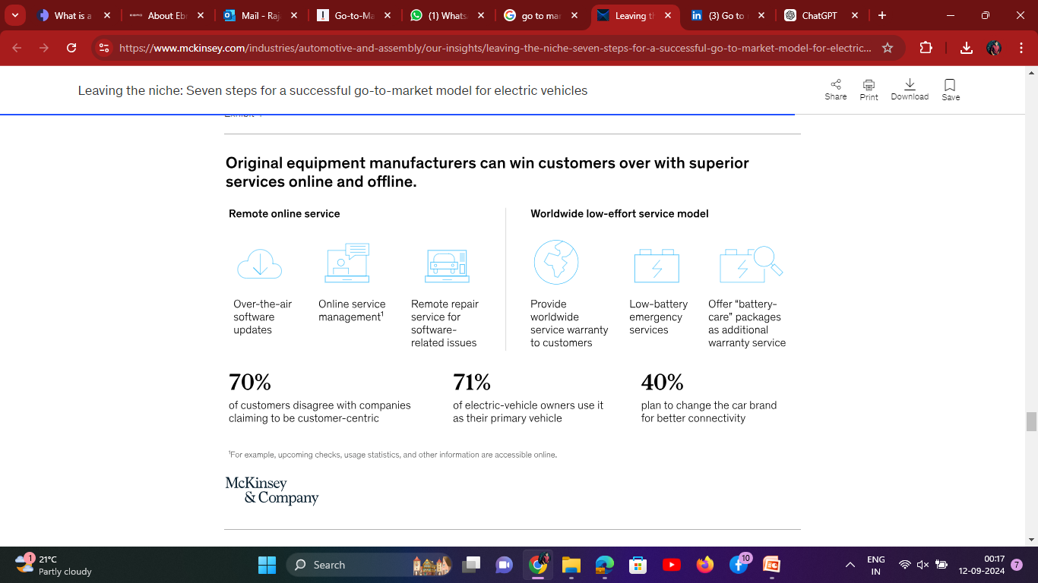
ONLINE & OFFLINE AFTER SALES SERVICES
EBRO could provide state-of-the-art after-sales services (such as parts-exchange reminders and software updates) that are always available and can be sent, in part, remotely over the air. Such services could significantly improve the customer experience.

Slide 32
STEP 7 CREATE A COMPETITIVE PRICING STRATEGY
KEY ELEMENTS TO CONSIDER
GOVERNMENT INCENTIVES: We need to analyze the different government subsidies and tax breaks available in each European country, as they can significantly impact the final price of an EV for consumers.
BATTERY TECHNOLOGY AND RANGE: Price EVs based on their battery capacity and driving range, as these are key factors influencing consumer choice.
CHARGING INFRASTRUCTURE: Consider the availability and cost of charging infrastructure in different regions, as this can affect the overall ownership cost for consumers.
COMPETITOR PRICING: Monitor the pricing strategies of other EV manufacturers in the European market to remain competitive.
MARKET SEGMENTATION: Identify different consumer segments (e.g., budget-conscious, premium, eco-conscious) and develop targeted pricing strategies for each group.
DYNAMIC PRICING: Explore the potential for dynamic pricing models where charging costs can vary depending on time of day, location, or grid demand.

Slide 33
STEP 8 CREATE A MEDIA MARKETING STRATEGY
CREATE A MEDIA MARKETING STRATEGY THAT INCLUDES:
Interactive Omni channel based website.
Services on after sales and pre sales.
Promotions should be done through social media channels such as Instagram, Facebook and Youtube & Social media influencers.
Extensive promotions to be done at various Motor shows and Auto Exhibitions.
Active participation in motor shows and Rallies.
EBRO can built a strong customer community and could help bridge the gap among customers and company
Develop email marketing campaigns focused on fleet managers, small businesses, and city-based service providers.
Collaborate with Charging Infrastructure Providers.
Free Trial Programs can be offered to businesses as the opportunity to test the EV van in their fleet for a limited time to experience its benefits.
Get coverage in major European media outlets.

Slide 34
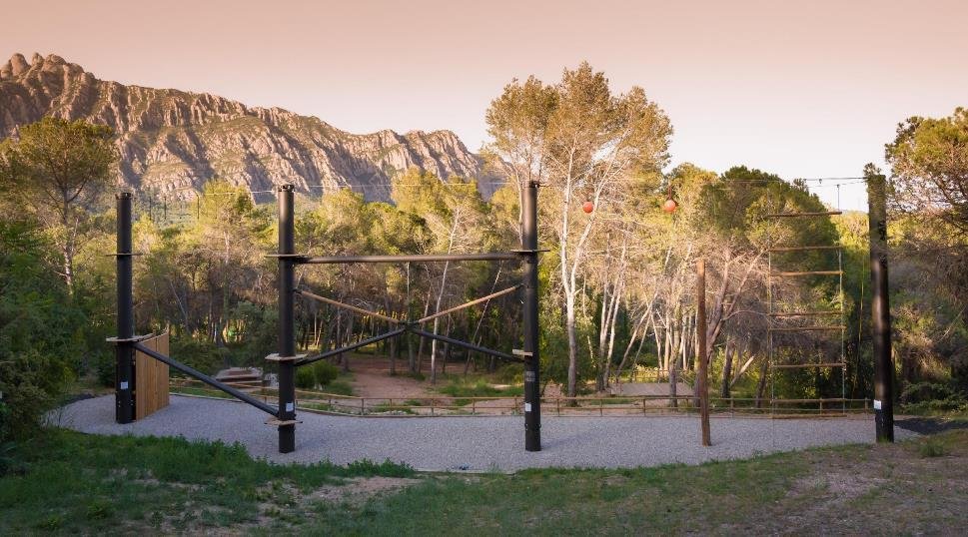

Thank you!

